Slide 1
TCP/IP Attacks DENIAL OF SERVICE Vitaly Shmatikov

Slide 2
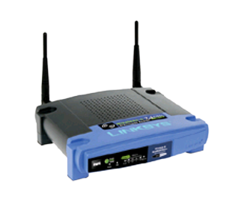
Warm Up: 802.11b
NAV (Network Allocation Vector)
15-bit field, max value: 32767
Any node can reserve channel for NAV microseconds
No one else should transmit during NAV period
… but not followed by most 802.11b cards
De-authentication
Any node can send deauth packet to AP
Deauth packet unauthenticated
… attacker can repeatedly deauth anyone

Slide 3

Steps to Send an HTTP Request
Pre HTTP/3
ISP1 DNS server
ISP1
Backbone
ISP2
ISP3
example.com
1.2.3.4
DNS lookup on example.com to get IP address (1.2.3.4)
TCP connection setup via 4-way handshake of IP packets to and from 1.2.3.4
Send HTTP request over TCP connection

Slide 4
Network Threat Models
Malicious ISPs
(on or off-path)
ISP1 DNS server
ISP1
Backbone
ISP2
ISP3
example.com
Subverted routers or links
(on-path)
1.2.3.4
Malicious hosts
(off-path)

Slide 5
Internet Is a Network of Networks
backbone
ISP
local network
Internet service
provider (ISP)
Autonomous system (AS) is a collection of IP networks under control of a single administrator (e.g., ISP)
local network
TCP/IP for packet routing and connections
Border Gateway Protocol (BGP) for route discovery
Domain Name System (DNS) for IP address discovery

Slide 6
Internet Protocol Stack
Application
Transport
Network
Link
Application
Transport
Network
Link
HTTP, DNS, SMTP, SSH, etc.
TCP, UDP
Network
Link
IP, ICMP
802x (Ethernet, 802.11)

Slide 7
Data Formats
application
layer
Application data
message
transport
layer
TCP
header
data
TCP
header
data
TCP
header
data
segment
network
layer
IP
header
TCP
header
data
packet
data link
layer
Ethernet
header
IP
header
TCP
header
data
Ethernet
trailer
frame

Slide 8
IP (Internet Protocol)
Connectionless
Unreliable, “best-effort” protocol
Uses numeric addresses for routing
Typically, several hops in the route
Alice’s computer
Bob’s ISP
Alice’s ISP
Packet
Source
128.83.130.239
Dest
171.64.66.201
128.83.130.239
171.64.66.201
Seq
3
Bob’s computer

Slide 9
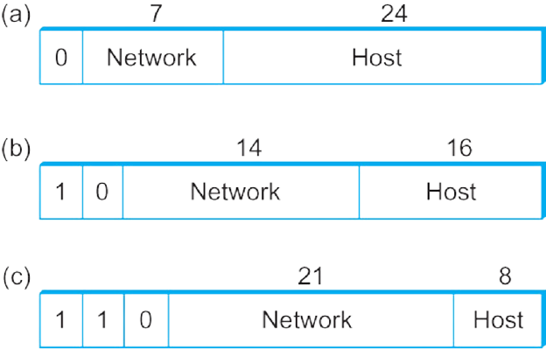
Global IPv4 Addresses
Globally unique
Hierarchical: network + host
Dot notation
10.3.2.4
128.96.33.81
192.12.69.77
Prefix of IP address identifies the network it belongs to
Class A network: owns all addresses with a given top byte
Class B network: … top 2 bytes
Class C network: … top 3 bytes

Slide 10

Subnet Definition
IP address
Subnet part: high-order bits
Host part: low-order bits
What’s a subnet ?
Device interfaces with the same subnet part of IP address
Can physically reach each other without an intervening router
223.1.1.1
223.1.1.2
223.1.2.1
223.1.1.4
223.1.2.9
223.1.2.2
223.1.1.3
223.1.3.27
subnet
223.1.3.1
223.1.3.2

Slide 11
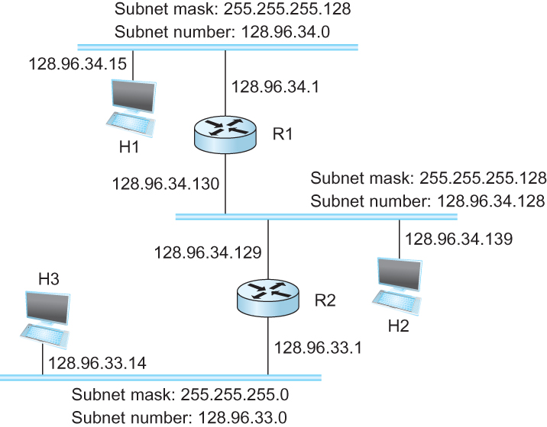
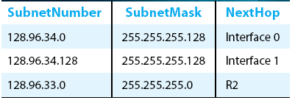
Subnetting Example
Forwarding Algorithm
D = destination IP address
for each entry <SubnetNum, SubnetMask, NextHop>
D1 = SubnetMask & D
if D1 = SubnetNum
if NextHop is an interface
deliver datagram directly to destination
else
deliver datagram to NextHop (a router)

Slide 12
CIDR: Classless Inter-Domain Level Routing
CIDR balances two objectives: (1) minimize the number of routes that a router needs to know, and (2) hand out addresses efficiently
CIDR uses aggregate routes
A single entry in the forwarding table tells the router how to reach a lot of different networks
No rigid boundaries between address classes
Variable number of bits per aggregated ranges of addresses

Slide 13
Classless Address Block Management
AS with 16 class-C networks: instead of handing out 16 class-C addresses at random, hand out a block of class-C addresses that share a common prefix
E.g., class-C network numbers from 192.4.16 through 192.4.31, so the top 20 bits of all addresses in this range are the same (11000000 00000100 0001)
This implicitly creates a 20-bit network number
Prefix convention: /X after prefix, where X is prefix length in bits
20-bit prefix for 192.4.16 through 192.4.31: 192.4.16/20
A single class-C network number, 24 bits long: 192.4.16/24

Slide 14
IP Forwarding w/ Longest Match
Router tables may have prefixes that overlap
Some addresses may match more than one prefix
Both 171.69 (a 16-bit prefix) and 171.69.10 (a 24-bit prefix) in the forwarding table of a single router
Packet destined to 171.69.10.5 matches both prefixes
Matching is based on the principle of
“longest match”
171.69.10 in the above case
A packet destined to 171.69.20.5 would match to 171.69 and not 171.69.10

Slide 15
Longest Prefix Matching
When looking for forwarding table entry for given destination address, use longest (ie, most specific) address prefix that matches destination address
Destination Address Range
11001000 00010111 00010*** *********
11001000 00010111 00011000 *********
11001000 00010111 00011*** *********
otherwise
Link interface
0
1
2
3
DA: 11001000 00010111 00010110 10100001
which interface?
DA: 11001000 00010111 00011000 10101010
which interface?

Slide 16
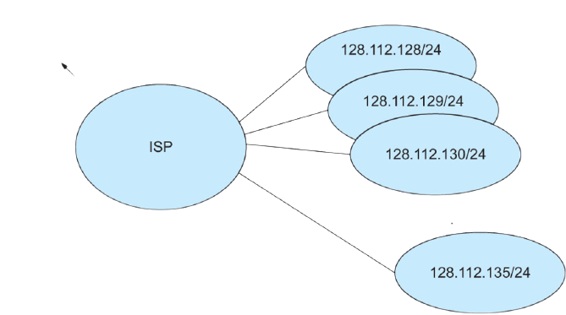
Classless Addressing
Network number may be of any length
Represent network number with a single <length, value> pair
Advertise 128.112.128/21

Slide 17


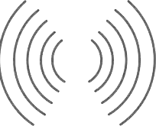

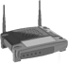


Transport Protocols
application
transport
network
data link
physical
Goal: provide logical end-to-end communication channel between app processes running on different hosts
Examples: TCP and UDP
logical end-end transport
application
transport
network
data link
physical

Slide 18
TCP (Transmission Control Protocol)
Sender: break data into packets, attach sequence number to every packet
Receiver: reassemble packets in correct order
Acknowledge receipt; lost packets are re-sent
Connection state maintained on both sides
remember received pages
and reassemble
book
mail each
page

Slide 19
User Datagram Protocol (UDP)
UDP is a connectionless protocol
Simply send datagram to application process at the specified port of the IP address
Source port number provides return address
Applications: media streaming, broadcast
No acknowledgement, no flow control, no message continuation

Slide 20
ICMP (Control Message Protocol)
Provides feedback about network operation
“Out-of-band” messages carried in IP packets
Error reporting, congestion control, reachability…
Destination unreachable
Time exceeded
Parameter problem
Redirect to better gateway
Reachability test (echo / echo reply)
Message transit delay (timestamp request / reply)

Slide 21
The Internet Was Designed in the 1970s…
All transmissions are in the clear
Eavesdropping
Nothing is authenticated or integrity-protected
Spoofing, packet injection, etc.
Anyone can freely talk to anyone
Denial of service
Image: Forbes

Slide 22
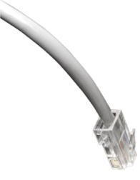
Packet Sniffing
Network interface card (NIC) in “promiscuous mode” reads all passing data
Many applications send data unencrypted
network

Slide 23
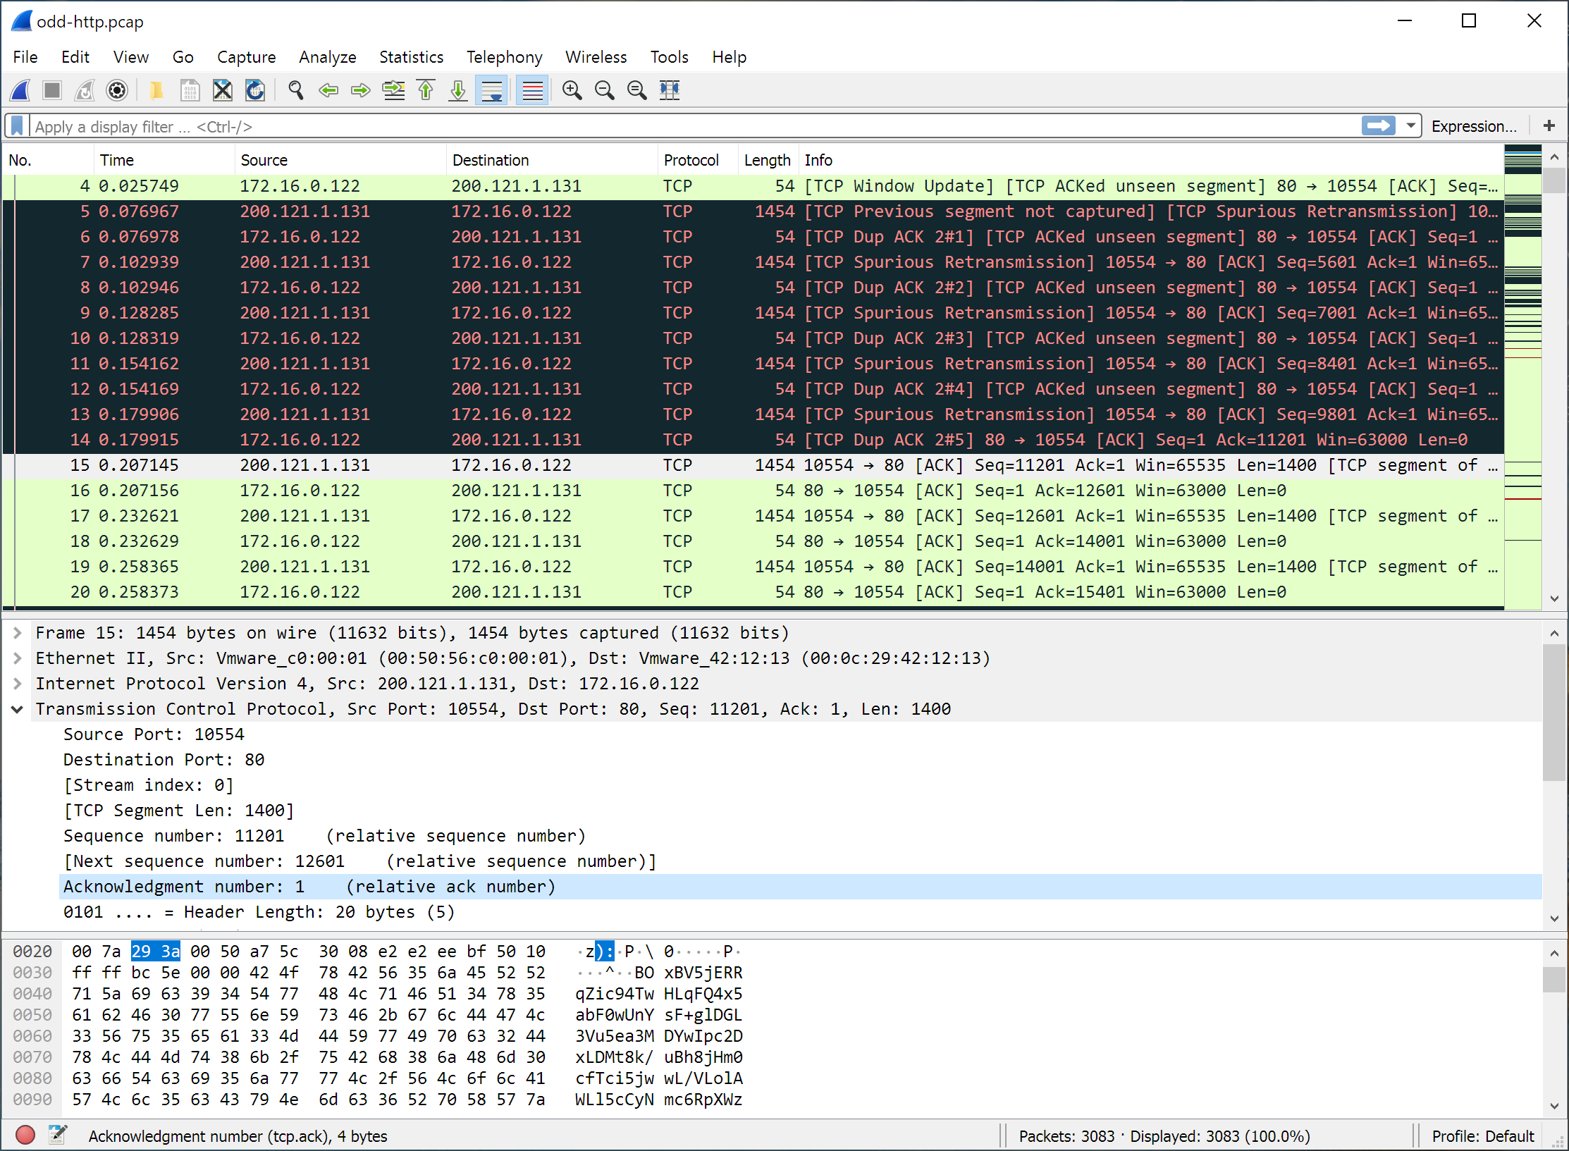

Wireshark: free, open-source protocol analyzer

Slide 24
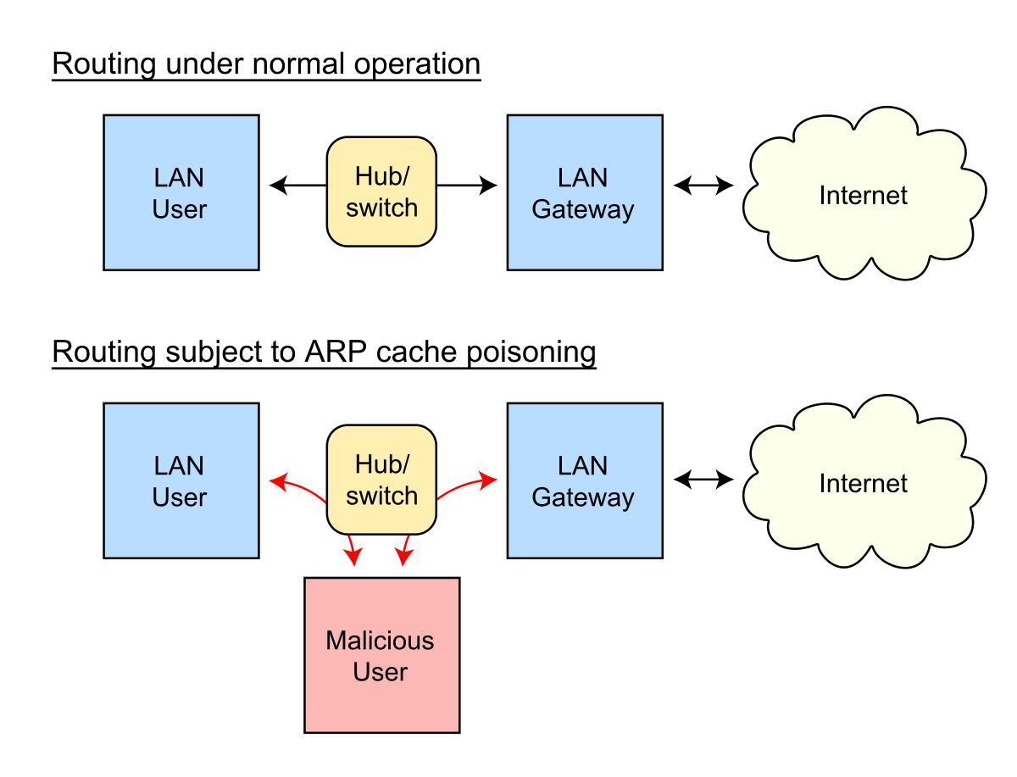
ARP Spoofing
The Address Resolution Protocol (ARP) is a communication protocol used for discovering the link layer address, such as a MAC address, associated with a given internet layer address, typically an IPv4 address
Using a fake ARP message, attacker on LAN associates his own MAC address with the victim’s IP address
Source: Wikipedia

Slide 25
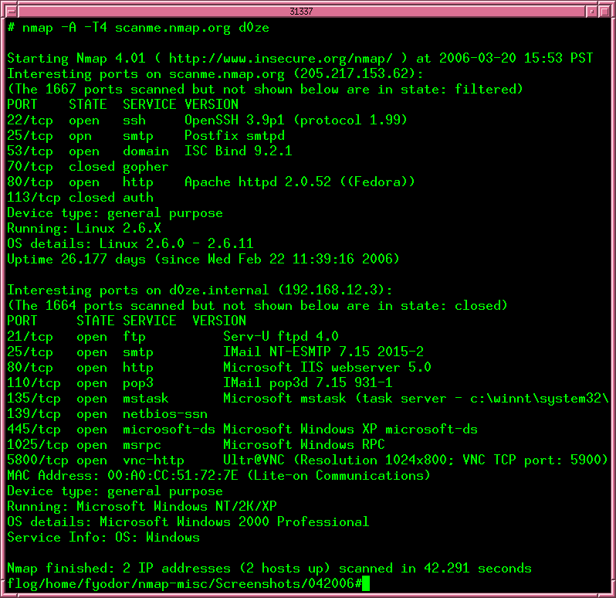
Port Scanning
Nmap: free, open-source network scanner
Many other tools available

Slide 26
TCP/IP Implementation Bugs
Solution: use up-to-date TCP/IP implementation, ingress filtering
“Ping of Death”
Old versions of Windows would crash if ICMP packet has payload longer than 64K (illegal per protocol RFC)
“Teardrop” and “Bonk”
Bad implementations of TCP/IP crash if Offset fields in TCP fragments are set to large or overlapping values
“Land”
IP packet with source address, port equal to destination address, port and SYN flag set triggers loopback in the Windows XP SP2 implementation of TCP/IP stack, locks up CPU
Common cause:
implementors assume that input will follow specification … but attackers can and will send malformed inputs

Slide 27
IP header
0
Version
Header Length
31
Type of Service
Total Length
TCP header
Identification
Flags
Fragment Offset
0
Source Port
Dest port
31
Time to Live
SEQ Number
Protocol
ACK Number
Header Checksum
Source Address of Originating Host
U
R
G
A
C
K
P
S
H
P
S
R
S
Y
N
F
I
N
Destination Address of Target Host
Other stuff
Options
Padding
IP Data

Slide 28

TCP Handshake
C
S
SYN_{C}
Listening…
Spawn thread,
store data
(connection state, etc.)
SYN_{S}, ACK_{S}
Wait
ACK_{C}
Connected

Slide 29
SYN Flooding Attack
IP does not verify or authenticate source address of packets
S
SYN_{spoofed} _{source addr 1}
Listening…
SYN_{spoofed} _{source addr 2}
Spawn a new thread,
store connection data
SYN_{spoofed} _{source addr 3}
… and more
SYN_{spoofed} _{source addr 4}
… and more
SYN_{spoofed} _{source addr 5}
… and more
… and more
MS Blaster (August 16, 2003):
every infected machine sent 50 packets per second to port 80 on windowsupdate.com
… and more

Slide 30
Low-Rate SYN Floods
OS | Backlog queue size
Linux 1.2.x | 10
FreeBSD 2.1.5 | 128
WinNT 4.0 | 6
Backlog timeout: 3 minutes
Attacker need only send 128 SYN packets every 3 minutes
Phrack 48, no 13, 1996

Slide 31
SYN Flooding Explained
Attacker sends many connection requests with spoofed source addresses
Victim allocates resources for each request
New thread, connection state maintained until timeout
Fixed bound on half-open connections
Once resources exhausted, requests from legitimate clients are denied
This is a classic denial of service pattern: it costs nothing to TCP initiator to send a connection request, but TCP responder must spawn a thread for each request - asymmetry!

Slide 32
Preventing SYN Floods
DoS is caused by asymmetric state allocation
If responder opens new state for each connection attempt, attacker can initiate thousands of connections from bogus or spoofed IP addresses
Cookies ensure that the responder is stateless until initiator produced at least two messages
Responder’s state (IP addresses and ports of the connection) is stored in a cookie and sent to initiator
After initiator responds, cookie is regenerated and compared with the cookie returned by the initiator

Slide 33
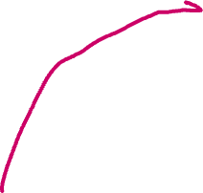
SYN Cookies
http://cr.yp.to/syncookies.html
C
S
SYN_{C}
Listening…
Compatible with standard TCP;
simply a “weird” sequence number
Does not store state
SYN_{S}, ACK_{S}
sequence # = cookie
Proof that IP address is not spoofed
F(source addr, source port,
dest addr, dest port,
coarse time, server secret)
Cookie must be unforgeable and tamper-proof
F=crypto hash
The only way for initiator to produce the valid sequence number in ACK is to receive the SYN-ACK at the same IP address
Recompute cookie,
compare with with the received cookie, establish connection only if they match
ACK_{C}
sequence # = cookie +1

Slide 34
Anti-Spoofing Cookies: Basic Pattern
Client sends request (message #1) to server
Typical protocol:
Server sets up connection, responds with message #2
Client may complete session or not - potential DoS!
Cookie version:
Server responds with hashed connection data instead of message #2
Client confirms by returning hashed data
If source IP address is spoofed, attacker can’t confirm
Need an extra step to send postponed message #2, except in TCP (can piggyback on SYN-ACK in TCP)

Slide 35
Another Defense: Random Deletion
SYN_{C}
half-open connections
121.17.182.45
If SYN queue is full, delete random entry
Legitimate connections have a chance to complete
Fake addresses will be eventually deleted
Easy to implement
231.202.1.16
121.100.20.14
5.17.95.155

Slide 36
Prolexic
Idea: only forward established TCP connections to site
Lots-of-SYNs
Prolexic
proxy
Lots-of-SYN/ACKs
Few ACKs
Web site
Forward
to site
Prolexic purchased by Akamai in 2014
Many companies: Cloudflare, Imperva, Arbor Networks, …

Slide 37
Other Junk-Packet Attacks
Proxy must keep floods of these away from website
Attack Packet | Victim Response | Rate: attk/day [ATLAS 2013]
TCP SYN to open port | TCP SYN/ACK | 773
TCP SYN to closed port | TCP RST
TCP ACK or TCP DATA | TCP RST
TCP RST | No response
TCP NULL | TCP RST
ICMP ECHO Request | ICMP ECHO Response | 50
UDP to closed port | ICMP Port unreachable | 387

Slide 38
Predictable Sequence Numbers
Backbone
5.6.7.8
ISP1
ISP2
ISP3
1.2.3.4
8.7.3.4
BSD 4.4 used predictable initial sequence numbers (ISNs)
At system initialization, set ISN to 1
Increment ISN by 64,000 every half-second
What can a clever attacker do?
(assume spoofing possible)

Slide 39
TCP Spoofing
Each TCP connection has associated state
Sequence number, port number
TCP state is easy to guess
Port numbers standard, seq numbers predictable
Can inject packets into existing connections
If attacker knows the initial sequence number and amount of traffic, can guess likely current number
Guessing a 32-bit seq number is not practical, but most systems accept large windows of sequence numbers (to handle packet losses), so send a flood of packets with likely sequence numbers

Slide 40
TCP Spoofing and Injection
Connection between 1.2.3.4 and 8.7.3.4
Backbone
ISP2
5.6.7.8
ISP1
ISP3
1.2.3.4
8.7.3.4
Forge a FIN packet from
8.7.3.4 to 1.2.3.4
Forge some application-layer
packet from 8.7.3.4 to 1.2.3.4
src: 8.7.3.4
dst: 1.2.3.4
seq#(8.7.3.4)
FIN
src: 8.7.3.4
dst: 1.2.3.4
seq#(8.7.3.4)
“rsh rm –rf /”
DoS by connection reset
Attacker can’t see server’s responses, but can bypass IP address-based authentication
(remote shell, SPF defense against spam)

Slide 41
Fixing Predictable Seq Numbers
Backbone
ISP2
5.6.7.8
ISP1
ISP3
1.2.3.4
Fix idea 1:
Random ISN at system startup
Increment by 64,000 each half second
8.7.3.4
Better fix:
Random ISN for every connection
SYN cookies ensure this
Remains an issue in some cases:
Any FIN accepted with seq number in receiver window: 2¹⁷ attempts
Side-channel attacks to infer seq number

Slide 42
Fixing Spoofing
Backbone
ISP2
5.6.7.8
ISP1
ISP3
1.2.3.4
8.7.3.4
IP traceback: techniques for inferring actual source of a (spoofed) packet
BCP 38 (RFC 2827): upstream ingress filtering to drop spoofed packets
Ideally, all network traffic providers would perform ingress filtering… but they don’t

Slide 43
https://spoofer.caida.org/summary.php

Slide 44
Denial of Service by Flooding
Backbone
ISP2
5.6.7.8
ISP1
1.2.3.4
Attacker’s goal: prevent legitimate users from accessing victim (1.2.3.4)
ICMP ping flood
Attacker sends ICMP pings as fast as possible to victim
When will this work as a DoS?
How can this be prevented?
Attacker resources > victim’s
Ingress filtering of attacker IP addresses near victim once attack identified

Slide 45

Avoiding Ingress Filtering
Ingress filtering
Backbone
ISP2
5.6.7.8
ISP1
1.2.3.4
ISP3
8.7.3.4
Attacker can send packet with fake (“spoofed”) source IP address. Packet will get routed correctly. Replies will not.
Distribute attack across many IP addresses

Slide 46
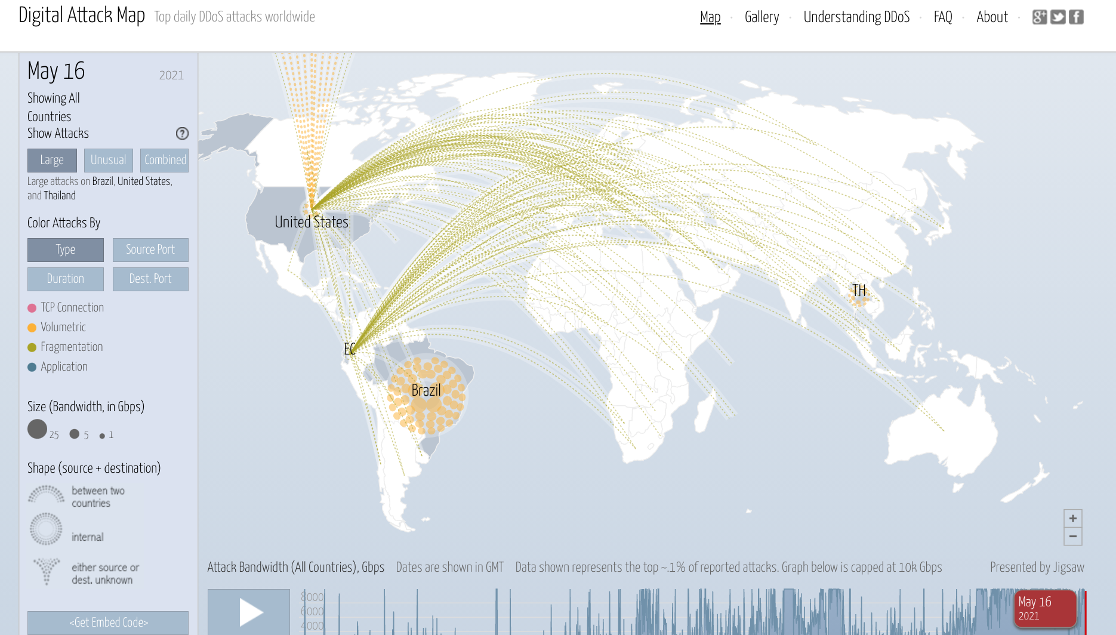
DISTRIBUTED Denial of Service

Slide 47
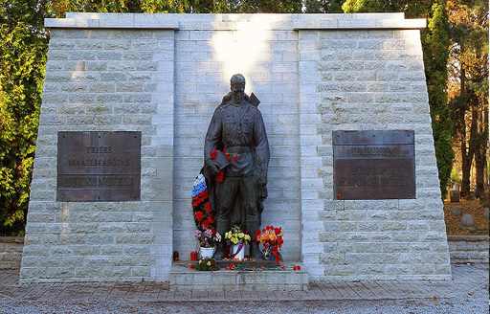

DDoS Attack on Estonia
1.2.3.4
Backbone
ISP2
5.6.7.8
ISP1
ISP3
1.2.4.3
8.7.3.4
8.7.1.3
April 27, 2007
Continued for weeks, with varying levels of intensity
Government, banking, news, university websites
Government shut down international Internet connections

Slide 48


Slide 49
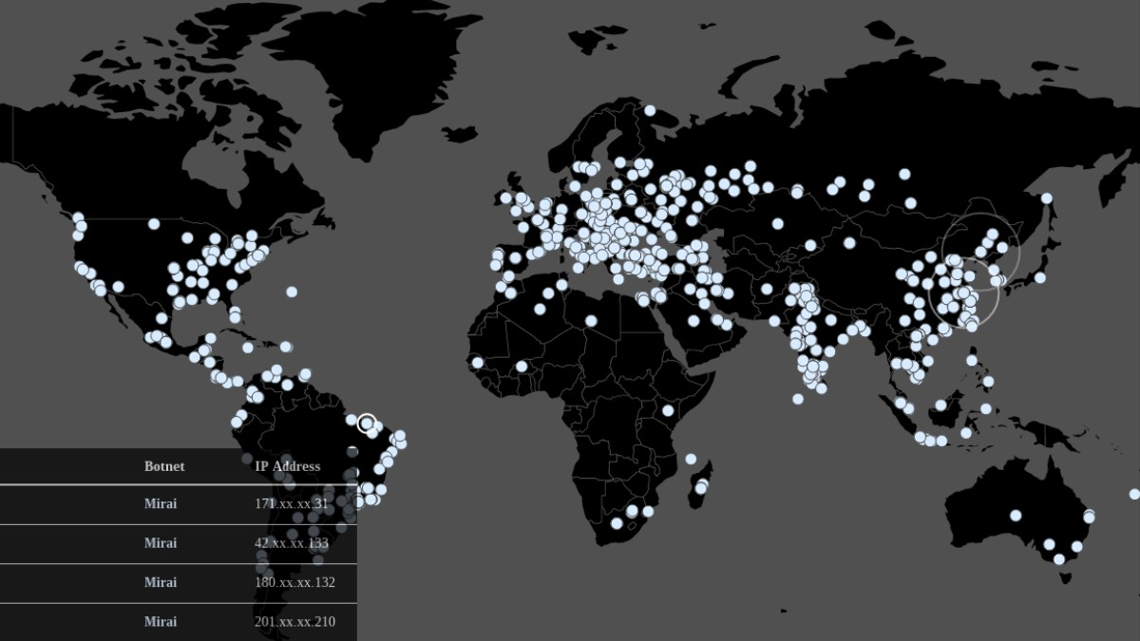


Mirai Botnet
Origin: game-booting code from Lizard Squad
Used in attacks on Sony PlayStation and Xbox Live networks
Scans big blocks of Internet address space for open telnet ports, logs in using default passwords
Assembled an army of 1 to 2.5 million IoT devices
In 2016, used to stage massive DDoS attacks on DYN’s DNS servers
Knocked out access to 1200 websites, including Twitter, Netflix, Paypal, Shopify, GitHub…
image: vice.com
Much more about DNS later

Slide 50
Amplification
Key element of many powerful DoS attacks
Achieves attacker resources >>> victim’s
1 request sent by attacker => N requests received by the victim
1 byte sent by attacker => N bytes received by the victim (N can be 200+ in some attacks)
Force victim to expend computation, logical resources

Slide 51
“Smurf” Reflector Attack
Solution: reject external packets to broadcast addresses
Looks like a legitimate
“Are you alive?” ping
request from the victim
Stream of ping replies
overwhelms victim
1 ICMP Echo Req
Src: victim’s address
Dest: broadcast address
Every host on the network
generates a ping (ICMP
Echo Reply) to victim
gateway
victim

Slide 52
NTP Reflection + Amplification
x206 amplification
“Give me the addresses of the
last 600 machines you talked to” spoofed SrcIP: victim
(234 bytes)
600 addresses
(49,000 bytes)
DoS Source
NTP
(Network Time Protocol)
server
victim
December 2013 – February 2014:
400 Gbps DDoS attacks involving 4,529 NTP servers
7 million unsecured NTP servers on the Internet (Arbor)

Slide 53
UDP in Reflection Attacks
DNS, memcached, … application-layer protocols running on UDP are often exploited in DoS attacks
Single packet to victim service yields response, so spoofing + reflection works
IP hdr
UDP hdr
data
16-bit
source port number
16-bit
destination port number
16-bit
UDP length
16-bit
UDP checksum
length = header len + data len

Slide 54

Memcached DDoS Attacks
Memcached is a popular in-memory data store
Supports UDP requests
Default configuration: accept UDP requests from anywhere
Standard reflector attack
Insert data into the Memcached server
Send UDP requests with source IP addr of victim

Slide 55

DDoS Attack on GitHub (Feb 2018)
51,000x bandwidth amplification
1.3 TB/s of traffic to GitHub from 1000+ ASes
GitHub offline for 5 minutes
Response
Use BGP announcement to route GitHub traffic through Akamai
Akamai gives more capacity + helps filter out bogus requests
Turn off UDP support in Memcached (now off by default)
https://github.blog/2018-03-01-ddos-incident-report/

Slide 56
TCP Con Flood
Command a bot/zombie army to:
Complete TCP connection to web site
Send short HTTP HEAD request
Repeat
Will bypass SYN flood protection proxy but attacker cannot use spoofed source IPs
Reveals location of bot zombies
Proxy can now block or rate-limit bots

Slide 57



Wired (September 11, 2021)
A massive botnet, dubbed Mēris, is believed responsible, flooding Yandex with millions of HTTP requests for webpages at the same time.
This DDoS technique is called HTTP pipelining, where a browser requests a connection to a server and, without waiting for a response, sends multiple more requests. Those requests reportedly originated from networking gear made by MikroTik. Attackers, according to Qrator Labs, exploited a 2018 bug unpatched in more than 56,000 MikroTik hosts involved in the DDoS attack.
The Mēris botnet delivered the largest attack against Yandex it has ever spotted (by traffic volume) – peaking at 21.8 million requests per second (RPS).
https://threatpost.com/yandex-meris-botnet/169368/

Slide 58
Other Countermeasures
Above
Transport
Layer
Kerberos
Provides authentication, protects against application-layer spoofing
Does not protect against connection hijacking
Above
Network
Layer
SSL/TLS and SSH
Protects against connection hijacking and injected data
Does not protect against DoS by spoofed packets
Above
Network
Layer
IPsec
Protects against hijacking, injection, DoS using connection resets, IP address spoofing

